Slide 1
Powered wheelchair simulator development: implementing combined navigation-reaching tasks with a 3D hand motion controller
Journal of NeuroEngineering and Rehabilitation 2016
IF:3.519

Slide 2
Introduction
1. Learning how to best navigate their powered wheelchair (PW) in order to reach for objects is crucial to PW users’ independence and quality of life.
2. This advanced task-related training is often not possible in rehabilitation centers as access to training for PWs is already limited.
3. Virtual reality (VR) simulators offer a highly feasible supplement for rehabilitation training either at home or in a clinical setting.
4. We integrated Hydra motion controller into the McGill Immersive Wheelchair (miWe) simulator, which enabled users to physically perform such manual tasks in combination with manoeuvring their wheelchair in the simulator.

Slide 3
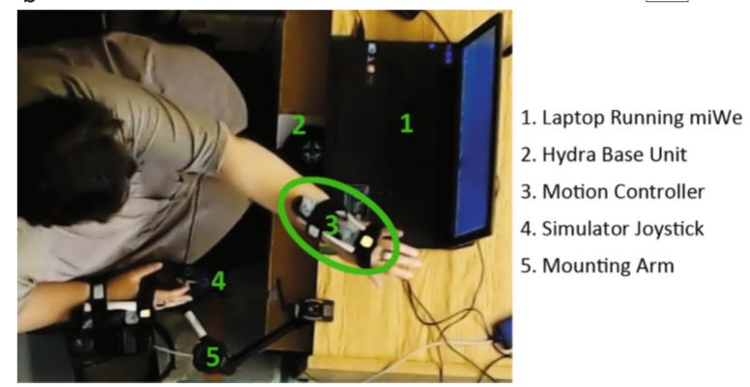
Methods
1. Hardware and software
(1) Razer Hydra motion controller (magnetic sensor).
(2) McGill Immersive Wheelchair (miWe) simulator with joystick.
(3) Laptop and mounting arm.

Slide 4
Methods
2. Population and sample
(1) This study focused on the participation of experienced PW users, with a minimum of 2 years’ experience.
(2) Inclusion criteria:
(a) 13 or more on the Montreal Cognitive Assessment.
(b) Having one able arm and hand for controlling the wheelchair.
(c) Able to grasp at 40 cm forward and laterally.
(d) Normal or corrected vision.

Slide 5
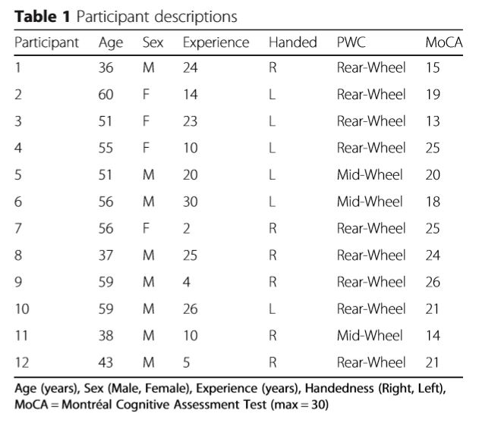

Slide 6
Methods
3. Procedures
(1) Participants performed 3 tasks in the RW and in the miWe simulator (VR).
(2) The starting environment was randomized, with 50 % of participants performing tasks in VR first.
(3) Participants performed each task 5 times.
(4) 3 tasks:
(a) Desk. Navigation -> Parking -> Take and placing the object in the drawer
(b) Elevator. Navigation -> Parking -> Pressing the elevator’s call button
(c) Door. Navigation -> Opening door -> Parking

Slide 7
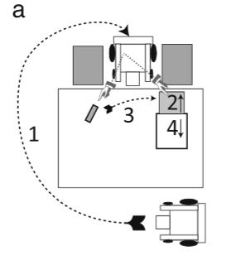

Slide 8
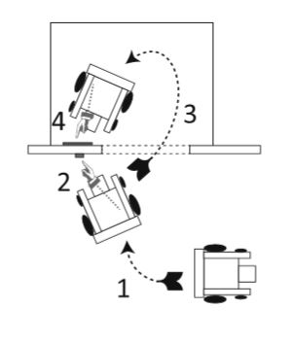
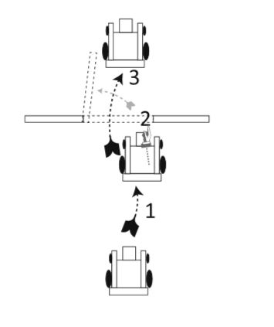

Slide 9
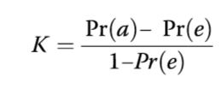
Methods
4. Data collection
(1) The iGroup Presence Questionnaire (IPQ) for sense of presence (SOP).
(2) Joystick movements: an excursion away from the neutral position (threshold of 10 %).
(3) Reaching movements: an effortful movement towards an object.
(4) Concordance between RW and VR tasks (Cohen’s Kappa coefficient): Pr(a) is the proportion of counted concordant cases and Pr(e) is the proportion of concordant cases due to ‘random chance’ behaviour.
(5) Completion time.

Slide 10
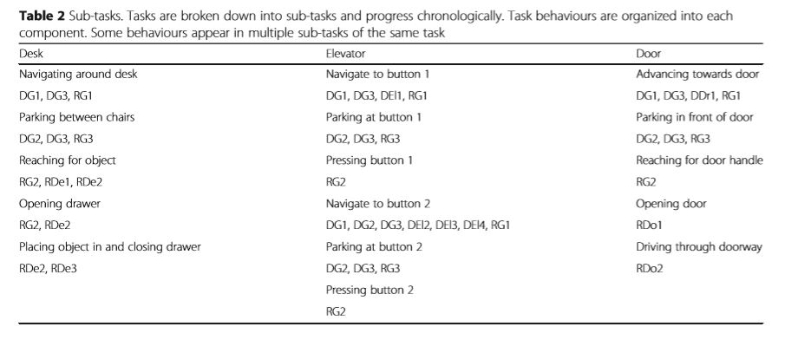
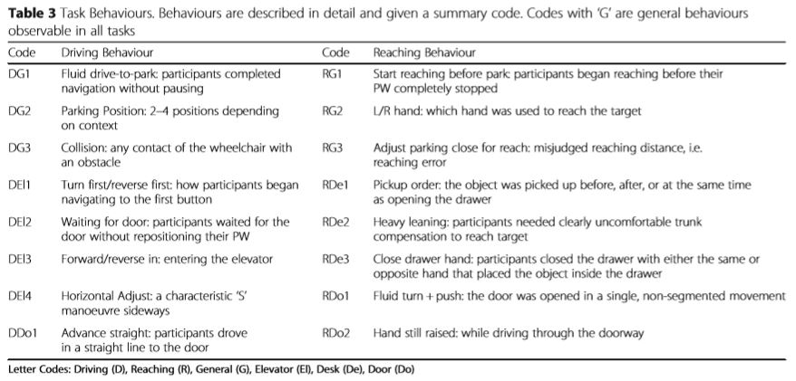

Slide 11
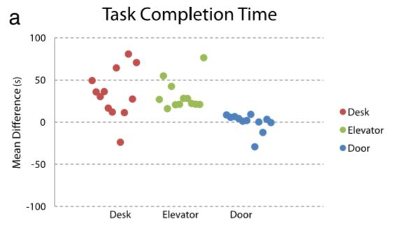
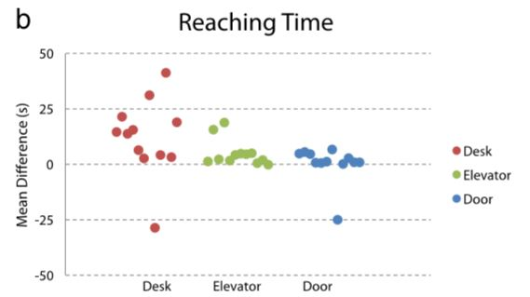
Result
1. Only the Door task demonstrated similar task completion times with no significant difference between VR/ RW.

Slide 12
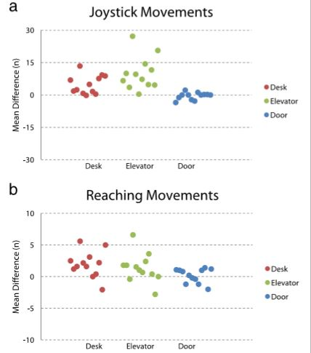
Result
2. The VR task shows noticeably more joystick movements than in the RW counterpart.
3. Similarly, the number of reaching movements utilized was concordant between RW and VR only for the Door task.

Slide 13
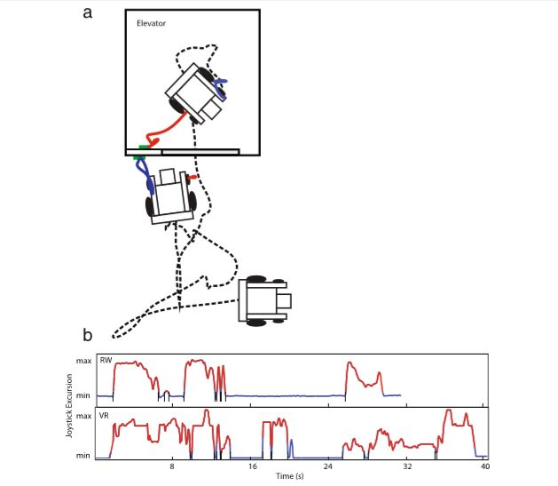

Slide 14
Result
4. Performance in the Desk task showed fair (0.4<K< 0.75) to excellent (K>0.75) agreement for most reaching behaviours except for the ‘close drawer hand’.
5. Performance in the Elevator task showed generally fair agreement RW and VR for driving and reaching behaviours.
6. Performance in the Door task showed generally fair agreement for driving and reaching behaviours.

Slide 15
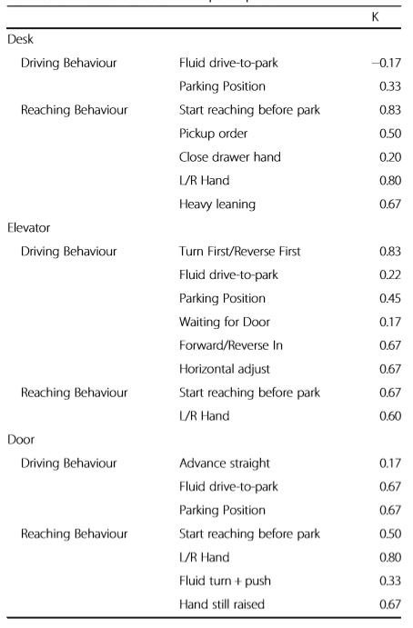

Slide 16
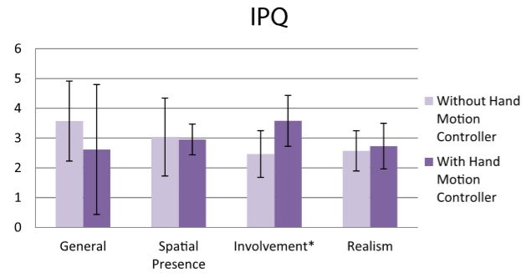
Result
7. In comparison with previous data collected on the miWe, without a reaching component, our results showed a significantly greater sense of ‘involvement’.

Slide 17
Discussion
1. The inclusion of the Razer Hydra 3D hand motion controller interface would increase the SOP in the miWe simulator. In the previous miWe study.
2. We found that, in two of three tasks (Desk and Elevator), task completion time, time spent reaching, number of joystick movements, and number of reaching movements were all significantly greater when the task was performed in VR compared to RW. Only the Door task showed any concordant performance measures.
3. The poorer navigation performance may be explained by a number of simulator limitations. A potential solution for these issues may be the utilization of low cost consumer-level HMDs.

Slide 18
Conclusion
1. This device is a valid interface for training and familiarizing combined manual-navigation tasks from a task planning/strategy standpoint and may be utilized in future versions of the simulator.
2. Future development will need focus on minimizing the experiential differences, with an emphasis on difficulty optimization.

